Slide 1
An Efficient Technique for Exploring Storage Organization in ASIP Synthesis
Manoj Kumar Jain
Prof. M. Balakrishnan and Prof. Anshul Kumar
Department of Computer Science & Engineering
IIT Delhi
http://www.cse.iitd.ernet.in/esproject
SRC semester presentation, Dec. 12, 2002

Slide 2
Outline
Introduction and Motivation
Overall Objectives
Methodology
Estimating Execution Time with Limited Regs.
Overheads due to Limited Reg. Windows and Cache Misses
Results and Validation
Conclusions and Future Work

Slide 3
Approaches in ASIP Design Space Exploration
Efficient retargetable compiler and simulator required
Slower
More accurate
More architectural features have been explored
Application
(C)
Retargetable
Compiler
Object
Code
Retargetable
Simulator
Simulator based
Architecture
Description
Trace Data
No target specific code generation
Faster
Less accurate
Less architectural features have been explored
Application
(C)
Architecture
Description
Profiler
Retargetable
Estimator
Scheduler based
Performance and
other Estimates

Slide 4
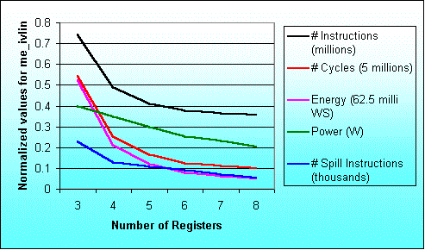
Result for the program me_ivlin
knee due to exec. time reduction
knee due to power saving

Slide 5
Overall Objectives
Fast design space exploration to explore increasing design space
Storage organization to be explored by scheduler based approach
Exploring register file size, register windows and cache configuration

Slide 6
Storage Exploration Methodology
Compute #window
Spills and Retores
Application + Per. Constraints
Cache simulator
Parameterized
Processor
Register allocation using RRCs
Scheduling
Parameterized
Memory
Execution time estimate
et_{R}
Overhead due to
window spills
oh_{W}
oh_{C}
Overhead due to
cache misses
Overall Execution time est.
ET
Storage configuration selector
ET = et_{R} + oh_{W} + oh_{C}

Slide 7
Methodology contd.
ET = et_{R} + oh_{W} + oh_{C}
Where
ET : Total application execution time
et_{R} : Execution time when reg. file contains R regs.
oh_{W} : Additional overhead due to window spills
oh_{C} : Additional overhead due to cache misses
et_{R} = bet + oh_{dep} + spill_{R} * t_{R}
bet : Base execution time (without storage constraints)
oh_{dep} : Overhead due to additional dependencies
spill_{R} : Number of register spills
t_{R} : Delay associated with each register spill
oh_{W} : spill_{W} * t_{W}
spill_{W} is number of window spills t_{W} is delay /window spill
oh_{C} = miss_{C} * t_{C}
miss_{C} is number of cache misses t_{C} is cache miss penalty

Slide 8
Exec. Time Estimates with Limited Registers: Methodology
Application
Profiling
Processor description
SUIF
Profile information
SUIF IR
Dependence analysis
Control flow graph
Data flow graph
Local register allocation
using reuse chains
Estimate overhead to
handle global needs
For each Basic Block
Modified data flow graph
Local execution time estimate
Schedule overhead
due to global needs
Scheduling
For each function
Schedule estimate of single
execution of the basic block
Execution time estimates

Slide 9
Register Allocation using Register Reuse Chains
A Register Reuse Chain or RRC contains
all the variables assigned to the same register
Generating Initial Chains [Zhang 99]
Converting Initial Chains into dependence conservative chains [Zhang 99]
Computing merging costs (Our contribution)
Efficiently merging chains (Our Contribution)

Slide 10
Allocation of Registers for Local and Global Needs
Overall schedule estimate for a block B
OE _{B} = minimum over all k ( LE _{B,k} + GE _{B,n-k} )
OE _{B} Total schedule estimate for basic block B
n Total registers available in all
k Registers used for local register allocation
n-k Registers available to handle global needs
LE _{B,k} Local schedule estimate
GE _{B,n-k} Global cost
Optimal distribution of total available registers into
registers for local allocation and to handle global needs
is taken at the basic block level.

Slide 11
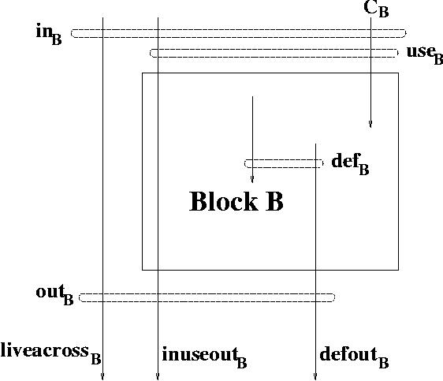
Variable Use Sets Analysis
Total register needs ||liveacross _{B} ^{R}|| + max(||defout _{B}|| + ||inuseout _{B}||, k)
||S|| Cardianility of set S
S ^{R} Subset of S which gets registers

Slide 12
Overheads due to Limited Register Windows
function calls and returns sequence is generated using application instrumentation [Vishal 2002]
Stack based analysis performed to know window spills (Our contribution)
Overhead computation
  Register file configuration (#windows, win. size)
  Processor configurartion

Slide 13
Overheads due to Cache Misses
Observation : Usually the number of memory locations required to store scalar variables and register winodws is small compared to total number of cache locations
Sim-cache from simplescalar tool set used to find memory access profiles
Overhead is computed as
d = α1 + α2 * (b - 1)
α1 : time for first data transfer from memory to cache
α2 : time for each remaining data transfer
b : block size

Slide 14
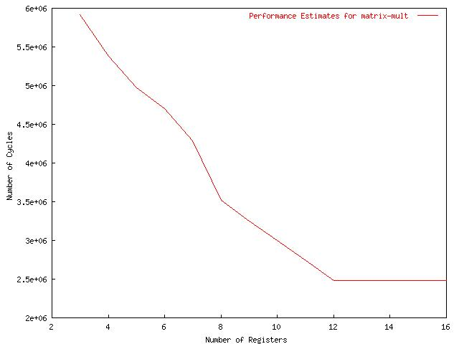
Excution time for matrix-mult with diff. Register file sizes for ARM7TDMI

Slide 15
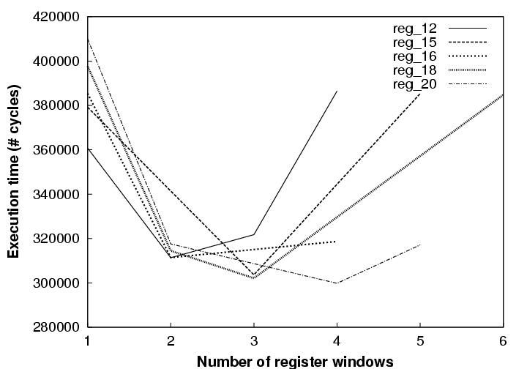
Trade off Number of Register Winodws and Window Size for LEON

Slide 16
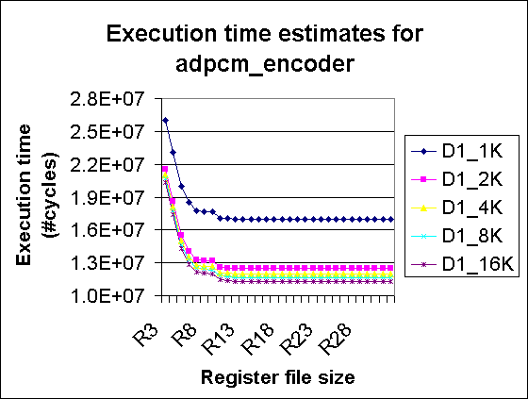
Exploring Reg. File and Cache Size

Slide 17
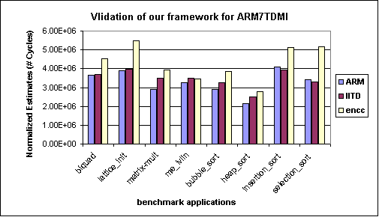
Validation of ASSIST for ARM7TDMI processor

Slide 18
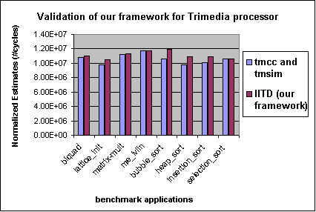
Validation of ASSIST for TM-1000 processor

Slide 19
Conclusions
Register allocation is performed before scheduling
Consider global needs
Extended to explore register windows and cache configurations
No target specific code generation or simulation
Simple processor description, retargetable
Performance is estimated using a scheduler and profile values
Validated for ARM7TDMI and TM-1000 and LEON processors
Nearly 77 times faster compared to compiler simulator framework

Slide 20
Future Work
Evaluate utility of our methodology
  Saving bits in instructions
  Exploit interesting use of unused registers
    Coprocessor interface in LEON
  Use some of unused registers for control/ status

Slide 21
Thanks

